Slide 1
Introduction to Pak Mail and Meal Plans

Slide 2
What is Pak Mail?
Pak Mail works as the post office and shipping provider on campus.
You can ship packages, buy stamps, and mail letters.
They also do money orders.

Slide 3
Where do you live?
If you live on campus, you can get a mailbox through Pak Mail, or you can use the IEP’s post office box for letter/packages.
IEP’s Address:
Kate Batson
Attn: *Your name here*
P.O. Box 350
Oxford, MS 38655
USA

Slide 4
How do I get a mailbox?
Go to: http://www.pakmailolemiss.com/mailbox-rental.php
Fill out the form. A small mailbox is $95
It’s that easy!

Slide 5
Meal Plans
Meal Plans are optional for students on and off campus.
There are some choices:
1. 5-Day Plus 1 for $575
2. Rebel 50 for $449
3. Rebel Unlimited Plus 1 for $1,850
4. Rebel 50 Plus 1 for $1,425

Slide 6
5-Day Plus 1
Can eat at Rebel Market, Marketplace at RC, or the Grill at 1810 once per day Monday-Friday
Or can eat at any other Ole Miss Dining Location once per day Monday-Friday with the total value used not going over $7.50
Good for students living off campus

Slide 7
Rebel 50
50 entries per semester to the Rebel Market, the Marketplace at the RC, or the Grill at 1810.
Can use 1 entry at the Union Food Court for $7.50 worth of food and drink purchase.
Good for students living off campus

Slide 8
Rebel Unlimited Plus 1
Unlimited personal entries per day to the Rebel Market, the Marketplace at the RC, or the Grill at 1810.
Can use 1 entry at the Union Food Court for $7.50 worth of food and drink purchase.
Good for students living on campus

Slide 9
Rebel 50 Plus 1
50 entries per semester to the Rebel Market, the Marketplace at the RC, or the Grill at 1810.
In addition, the 50 entries can be used at the Student Union Food Court for a $8.00 equivalence towards prepared food and beverage purchases.
Can use 1 entry per day at the Union Food Court for $8.00 worth of food and drink purchase.
Good for students living on campus

Slide 10
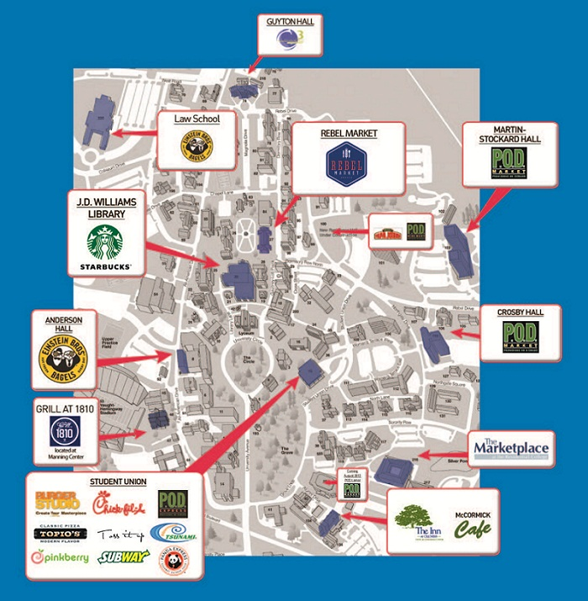

Slide 11
How do I get a meal plan?
Go to the ID Center
Fill out the request form
The cost for the meal plan will be charged to your Bursar account
Once you buy it, there’s no refunds

Slide 12
Any Questions?

